Slide 1
Eastern Mediterranean Centre for Oceanography and Limnology:
M. NAMIK ÇAĞATAY
Notes:
2

Slide 2
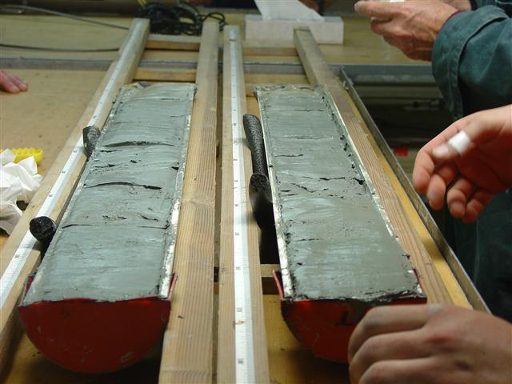
Natural Hazards and Environmental Change
EMCOL Research Fields
Earthquakes and earthquake risk assesment
Submarine landslides
Records of past tsunamis and tsunami risk assesment
Sea -level changes
Climate change - paleoclimatology
Ecological changes

Slide 3
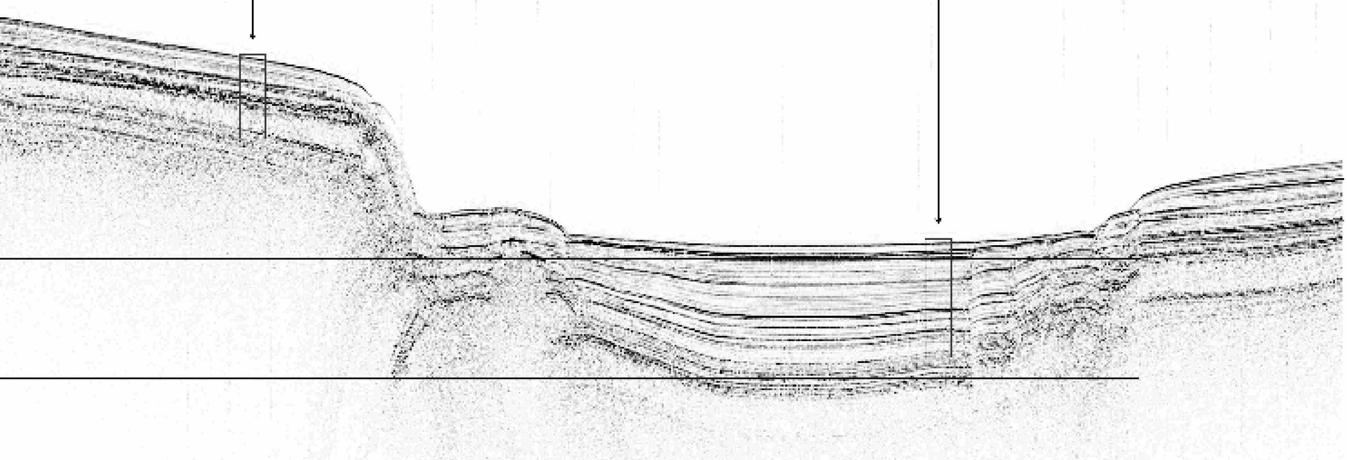
EMCOL
Fieldwork
Sub-bottom (Chirp) profiler and Differential GPS
CTD probe ( with dissolved oxygen sensor)
Figure 1. Mapping of active faults with sub-bottom (Chirp) profiler
Fault line
Notes:
5

Slide 4
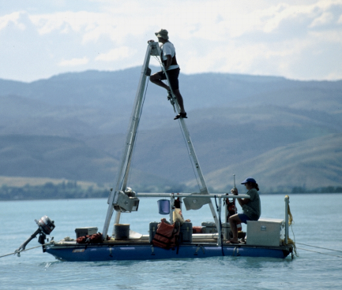
EMCOL
Fieldwork
Sediment sampling
Vibracorer
Gravity corer (5 m)
Kajak corer
Livingstone piston corer (30 m rod)
Ekmann dredge
Drilling equipment for coastline (20 m )
Supporting Equipment
Platform (4m x 3.5 m) & tripod
Small boat and engine
Notes:
6

Slide 5
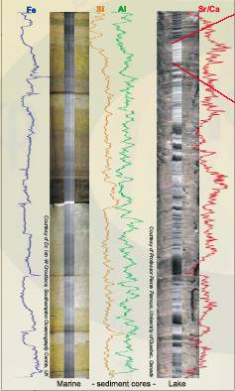
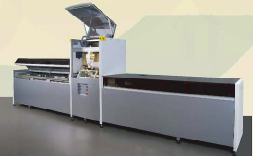
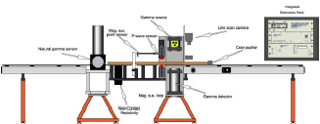
EMCOL’s Facilities
Core Analysis Laboratory
Itrax (XRF) Core Scanner
Multi-Sensor Core Logger
Figure 2
Notes:
7

Slide 6
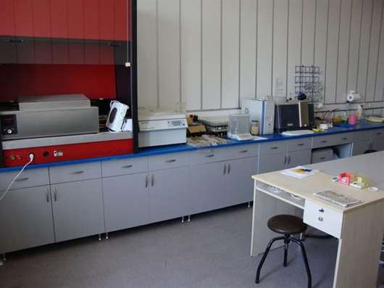
EMCOL’s Facilities
Sedimentology Laboratory
Freeze-drier
Laser Fritsch Particle Sizer Analysette
Centrifuge for clay and fossil seperation
Sample pounding
Notes:
8

Slide 7
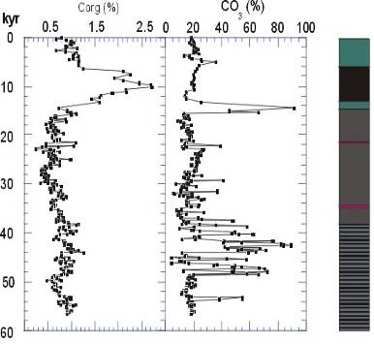
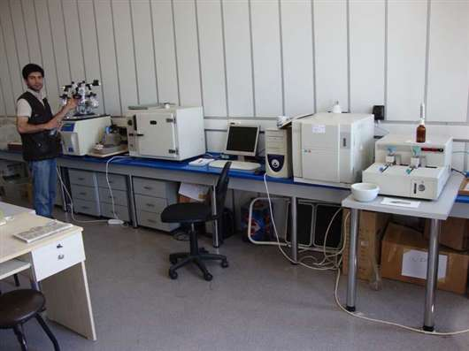
EMCOL’s Facilities Geochemistry
Total Organic and inorganic carbon analysis with Shimadzu TOC Analyzer
Figure 3. Total organic and inorganic carbon analysis in Marmara Sea sediment core (Çağatay et al., 2004)
MD-2430
Sapropel layer
Diagenetic carb.
Notes:
9

Slide 8
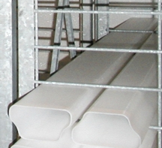
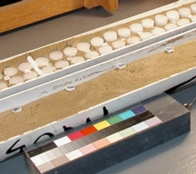
EMCOL
Cold Core Repository
210 horizontal shelves for 1 m cores
Constant temperature monitoring and alarm system
Wet Core Laboratory
Core slicing
Photography and lithological description
Sampling
Wet sieving
Notes:
10

Slide 9
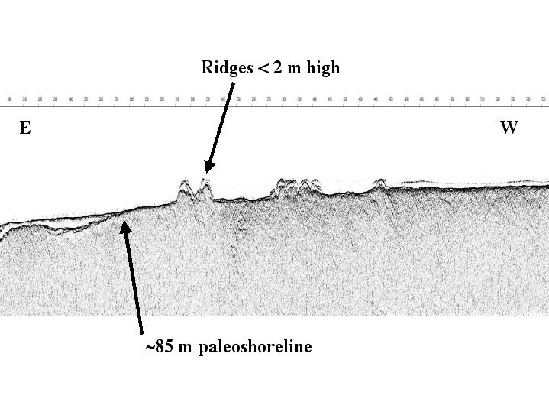
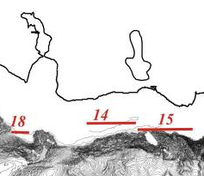
Paleoshorelines and Sea-level changes
EMCOL Research Applications
Figure 4.

Slide 10
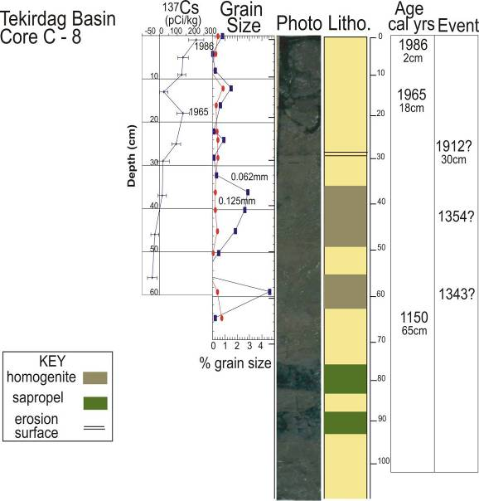
EMCOL Research Applications
Recognition of past earthquakes with the grain size analysis and dating with Cs-137 method
Figure 5. McHugh, Çagatay et al. (2003)

Slide 11
Sapropel (period of oxygen depletion)
EMCOL Research Applications
Research of past hydrology and climate change records
Figure 6. A core section from Marmara Sea
Freshwater-marine water transition, 12 kyr BP
¹⁴C age
Freshwater period
Çağatay et al. (2000) Mar. Geol.

Slide 12
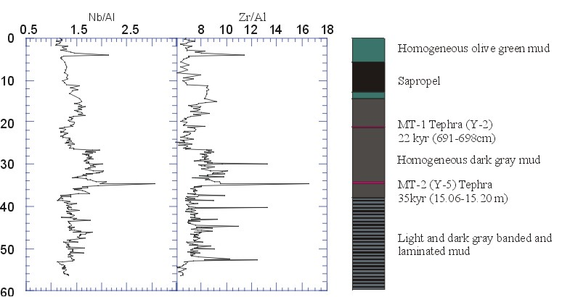
Research in EMCOL
Records of past volcanic activities
Vezüv?
Figure 7. Çağatay et al. (2004)

Slide 13
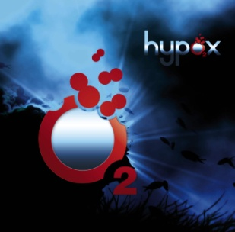
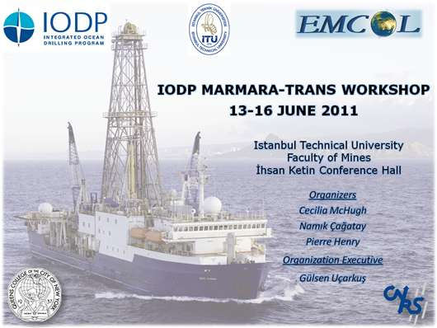
Projects

